Slide 1
INFO-3142
Python Basics

Slide 2
Indentation and Block Structuring
Python differs from most other programming languages because it uses whitespace and indentation to determine block structure
n = 9 r = 1
while n > 0:
r = r * n
n = n - 1
Python doesn’t use braces to indicate code structure; instead, the indentation itself is used
The last two lines of the previous code are the body of the while loop because they come immediately after the while statement and are indented one level further than the while statement
If those lines weren’t indented, they wouldn’t be part of the body of the while

Slide 3
Comments
Anything following a # symbol in a Python file is a comment and is disregarded by the language
The obvious exception is a # in a string, which is just a character of that string
# Assign 5 to x
x = 5
x = 3 # Now x is 3
x = "# This is not a comment"

Slide 4
Variables and Assignments
In Python, variables aren’t buckets
Instead, they’re labels or tags that refer to objects in the Python interpreter’s namespace
Any number of labels (or variables) can refer to the same object, and when that object changes, the value referred to by all those variables also changes

Slide 5
Variables and Assignments
a = 1
b = a
c = b
b = 5
print(a, b, c)
#1 5 1

Slide 6
Variables and Assignments
x = "Hello"
print(x)
#Hello
x = 5
print(x)
#5
del x
print(x)
Traceback (most recent call last):
File "<stdin>", line 1, in <module>
NameError: name 'x' is not defined

Slide 7
Expressions
Note that arithmetic operators involving only integers do not always return an integer
Even though all the values are integers, division (starting with Python 3) returns a floating-point number, so the fractional part isn’t truncated
If you want traditional integer division returning a truncated integer, you can use // operator instead

Slide 8
Expressions
x = 3
y = 5
z = (x + y) / 2
print(z)
z = (x + y) / 3
print(z)
z = (x + y) // 3
print(z)

Slide 9
Strings
x = "Hello, World“ # string literal
x = "\tThis string starts with a \"tab\"." # escape characters
x = "This string contains a single backslash(\\)."
x = "Hello, World"
x = 'Hello, World'
x = "Don't need a backslash"
x = 'Can\'t get by without a backslash'
x = "Backslash your \" character!"
x = 'You can leave the " alone'
x = """Starting and ending a string with triple " characters
permits embedded newlines, and the use of " and ' without
backslashes"""
print(x)

Slide 10
Strings
You can’t split a normal string across lines. This code won’t work:
# This Python code will cause an ERROR -- you can't split the string across two lines.
x = "This is a misguided attempt to
put a newline into a string without using backslash-n"

Slide 11
Numbers
Python offers four kinds of numbers: integers, floats, complex numbers, and Booleans
An integer constant is written as an integer—0, –11, +33, 123456—and has unlimited range, restricted only by the resources of your machine
A float can be written with a decimal point or in scientific notation: 3.14, –2E-8, 2.718281828
The precision of these values is governed by the underlying machine but is typically equal to double (64-bit) types in C
Booleans are either True or False and behave identically to 1 and 0 except for their string representations

Slide 12
Numbers
print(5 + 2 - 3 * 2)
#1
print(5 / 2) # floating-point result with normal division
#2.5
print(5 / 2.0) # also a floating-point result
#2.5
print(5 // 2) # integer result with truncation when divided using '//'
#2
print(30000000000) # This would be too large to be an int in many languages
#30000000000
print(30000000000 * 3)
#90000000000

Slide 13
Numbers
print(30000000000 * 3.0)
#90000000000.0
print(2.0e-8) # Scientific notation gives back a float
#2e-08
print(3000000 * 3000000)
#9000000000000
print(int(200.2))
#200
print(int(2e2))
#200
print(float(200))
#200.0

Slide 14
Built-in Numeric Functions
abs, divmod, float, hex, int, max, min, oct, pow, round

Slide 15
Advanced Numeric Functions
from math import *
…
acos, asin, atan, atan2, ceil, cos, cosh, e, exp, fabs, floor, fmod, frexp, hypot, ldexp, log, log10, mod, pi, pow, sin, sinh, sqrt, tan, tanh

Slide 16
Numeric Computation
The core Python installation isn’t well suited to intensive numeric computation because of speed constraints
But the powerful Python extension NumPy, provides highly efficient implementations of many advanced numeric operations
The emphasis is on array operations, including multidimensional matrices and more advanced functions such as the Fast Fourier Transform
You should be able to find NumPy (or links to it) at www.scipy.org

Slide 17
Complex Numbers
print((3+2j))
#(3+2j)
print(3 + 2j - (4 + 4j))
#(-1-2j)
print((1 + 2j) * (3 + 4j))
#(-5+10j)
print(1j*1j)
#(-1+0j)
z = 3+5j
print(z.real)
#3.0
print(z.imag)
#5.0

Slide 18
Advanced Complex Numbers
import cmath
print(cmath.sqrt(-1))
#1j

Slide 19
The None Value
In addition to standard types such as strings and numbers, Python has a special basic data type that defines a single special data object called None.
As the name suggests, None is used to represent an empty value
It appears in various guises throughout Python
For example, a procedure in Python is just a function that doesn’t explicitly return a value, which means that by default, it returns None

Slide 20
Getting User Input
name = input("Name? ")
#Name? Jane
print(name)
#Jane
age = int(input("Age? "))
#Age? 28
print(age)
#28

Slide 21
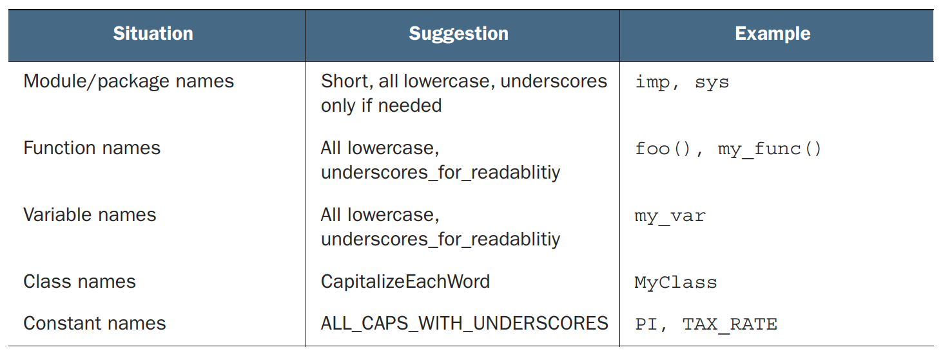
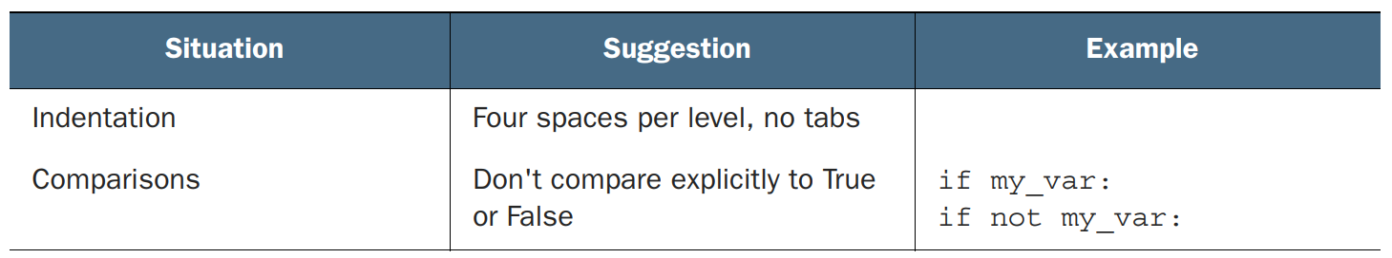
Basic Python Style

